Slide 1
Respect Diversity Art and Poetry Contest
2011 Entries

Slide 2
Come Together
The earth is the host of many creatures. This artwork is based on Rangoli designs. As an expression of warm hospitality, this design symbolizes the earth by using plant motif, colored sands, and grains. All the elements come together to enhance each other to create beauty.
3rd Grade Students
Heronville Elementary
Oklahoma City Public Schools

Slide 3
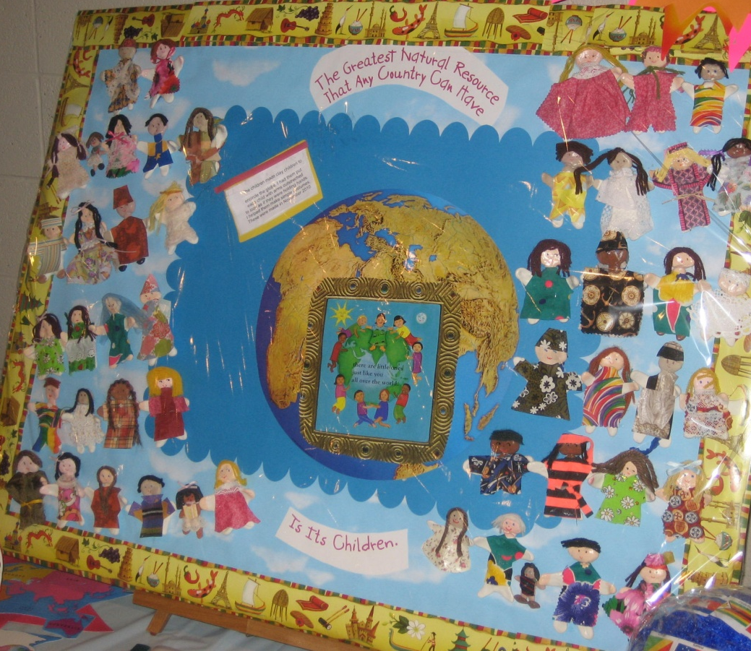
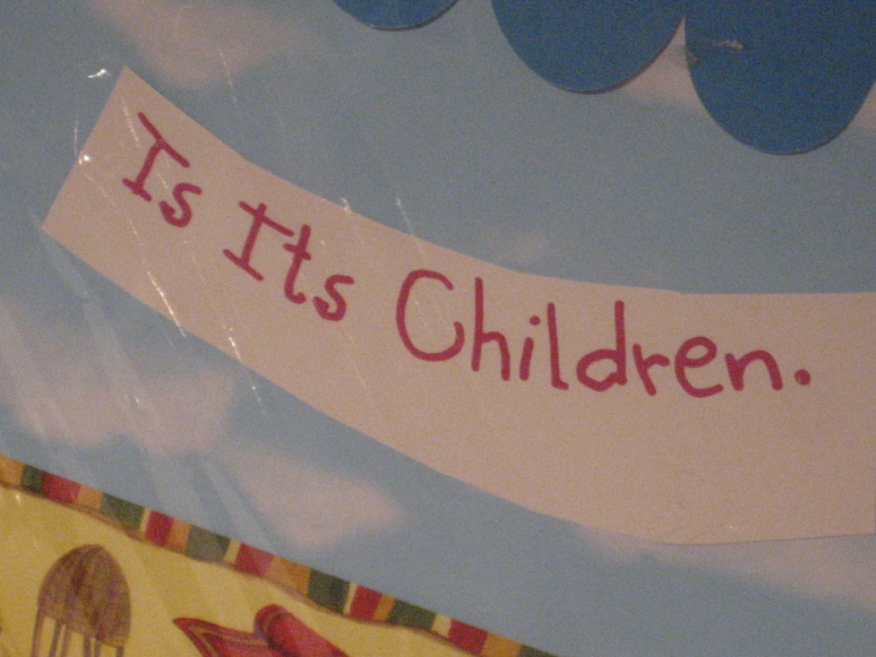
We Are a Rainbow of Peace
Peace is being free, giving a friend a hug, making new friends, helping your neighbor, reading different kinds of books, planting a tree, sharing clothes and a meal, learning another language…. Peace is being you and accepting others for their true colors.
Pre-K & Kinder-garten
Preschool Students
Villa Teresa
Oklahoma City

Slide 4
I Am A Seed of Peace
The annual Peace Festival includes a children’s activity room with a story quilt and peace activities. This year, children who attended added to “I Am a Seed of Peace”
Children at the
2010 OKC Peace Festival
A program of Peace House and the Peace Education Institute

Slide 5
Leave Only Footprints, Take Only Pictures
Students drew their shoes as still life drawings. Through this art project students learn the concept of returning places we visit in better shape after we leave them. Caring for the earth should be the concern of everyone.
5th Grade Students
Parmelee Elementary
Oklahoma City Public Schools

Slide 6
Nurture the Earth
Colorful clay pieces in our mosaic represent the many diverse individuals that make up our world.
The tree is life putting down roots, transforming into hands of different cultures to show the need to care for and nurture the earth.
High School Students
Putnam City Academy
Putnam City Public Schools
Oklahoma City

Slide 7
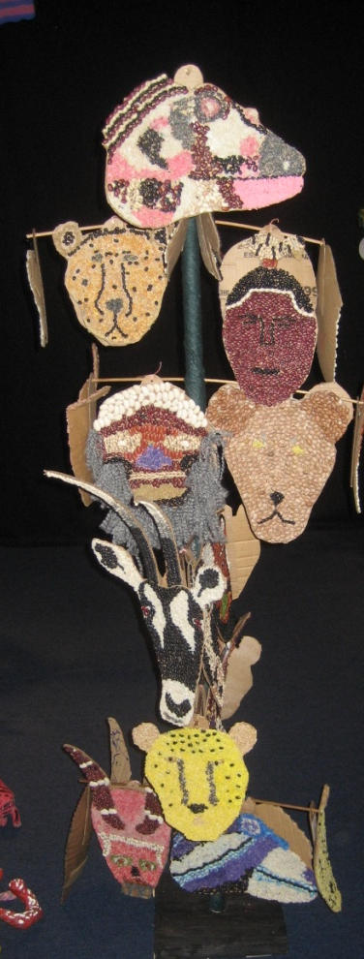
Protectors of the Earth
We as people are the protectors of the earth. The choices that we make affect not only ourselves but in the web of time those choices affect us all. Made of recycled and reused articles, the Oaxaca Animals encircle the earth with the totem poles standing in respect to the creation of the world and all in it, reminding us that we truly do “Care for the Earth”!
Middle School
Students
Middle School of Piedmont
Piedmont

Slide 8
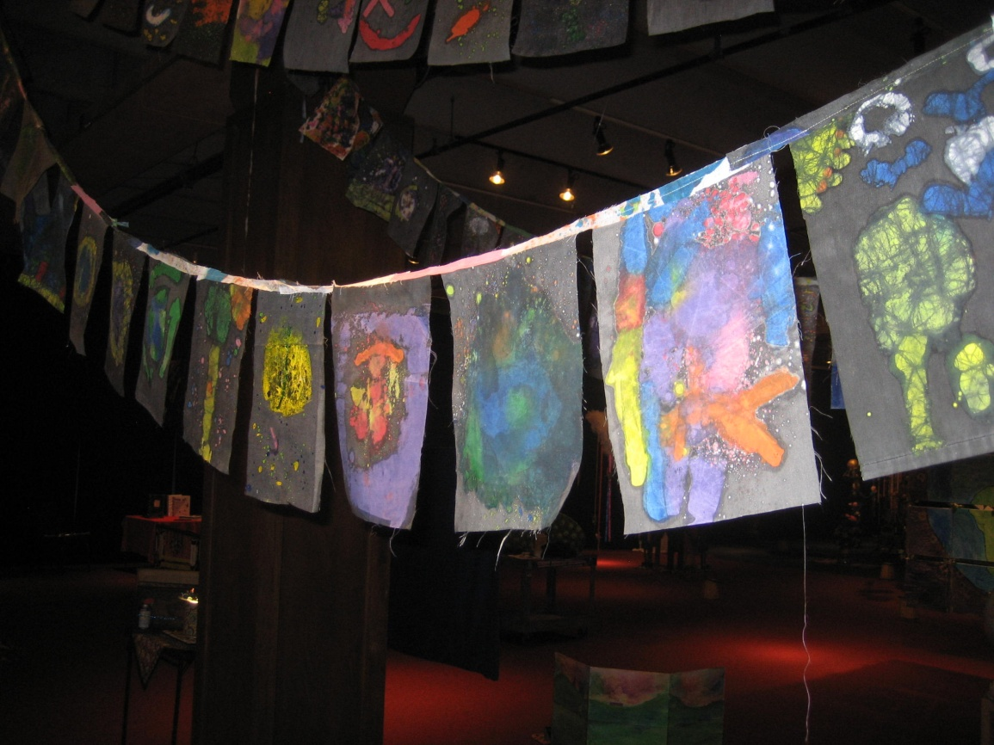
May Peace Prevail on Earth
May Peace Prevail on Earth is inspired by cultural flags. Each flag is rich in color and symbolism. Each flag combines its message to create a story. Our flags contain imagery of earth, animals, and people to show beautiful, individual parts together to become a whole.
Students
Central Elementary
Moore Public Schools

Slide 9
Go Wild…Compassion for all of G-d’s Creatures
Our 2010 summer camp theme was “Go Wild @ Camp Chaverim”…Where Happy Campers Roam! Painted on the back of the Camp Chaverim bench are the words “Tza’ar Ba’alei Chayim” which mean “Showing Kindness to all Living Creatures.”
Campers
Camp Chaverim
Jewish Federation of Greater OKC

Slide 10
Respect Variation
The inspiration behind this piece is the fact that the Shinnyo-en Foundation promotes harmony between different cultures and races, or variety in the human race.
The author is Zainab Shakir.
Created by Zainab Shakir, student Casady School
Oklahoma City

Slide 11
It Takes Everybody!
The life we enjoy depends on all kinds of people all over the world. We might seem very different but we share a responsibility to take care of the earth and each other. The health of the environment is a reflection of all of us.
8th Graders
Cushing Middle School
Cushing

Slide 12
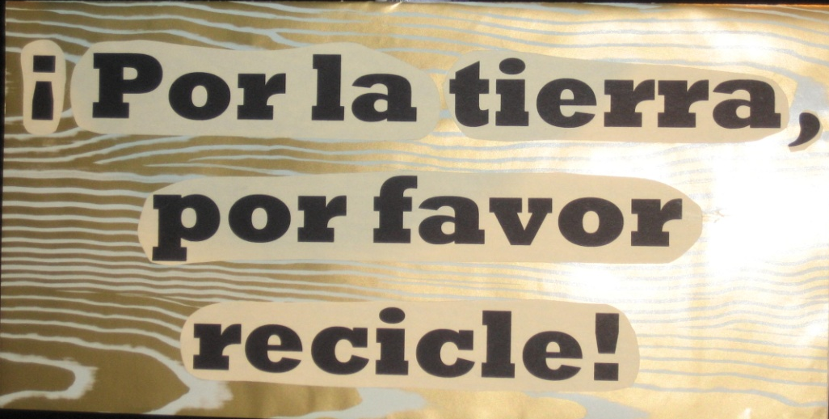
For Earths Sake Recycle!
We cannot afford to continue polluting our world.
We discovered that every nation has a word for recycling.
Now is the time for our actions to start speaking louder than our words.
7th Graders
Belle Isle Middle School
Oklahoma City Public Schools

Slide 13
Save the Future
After learning about different ways to recycle and its connection to preserving the world for all people and animals, our students created a sculpture made from renewable and nonrenewable resources. The diversity of the materials used represents the diversity of people and animals.
1st – 3rd Grades
3rd Grade Students
Orvis Risner Elementary
Edmond Public Schools

Slide 14
We’ve Got the Whole World, In Our Hands
We are all a part of the great cycle of life. Every culture, mythology, and belief shares in common that we are all connected to each other demanding our love, compassion, and respect to keep going strong for our future.
7th and 8th grade students
East Ink
Highland East Junior High
Moore Public Schools

Slide 15
A New Day For Everyone
“Caring for Earth” means caring for our connection to the natural cycles of the day and year. This begins an appreciation for the role of the sun in life on Earth. Our original poems celebrate the arrival of the sun each morning in a tone of reverence and wonder.
4th Graders
Casady School
Oklahoma City

Slide 16
A Turn for the Better
The theme of friendship with the people, animals and earth is an Islamic imperative . The students were enthusiastic about the natural way their project lends itself to the three most common characteristics of Islamic art: geometry, arabesque and calligraphy.
11th grade students
Tulsa Peace Academy
Tulsa

Slide 17
Caring Voices
When one speaks for peace and justice, they are speaking from the heart with open hands, courage, mind and heart. And they also have knowledge that they don’t know everything. May we at OCCC be caring voices for our community and for our state!
Students
Oklahoma City Community College
Oklahoma City

Slide 18
WE ARE THE WORLD
In creating the “We Are the World” sculpture, the kids were able to create from many different media/forms of creative expression:
Poetry, singing, paper mache, and painting as well as learning about customary dress and languages from other countries. Our inspiration is for these kids to have a deeper meaning of respect for themselves and for everyone around them, because everyone is different.
Young Patients
St. Anthony Hospital Human Restoration Unit
Oklahoma City

Slide 19
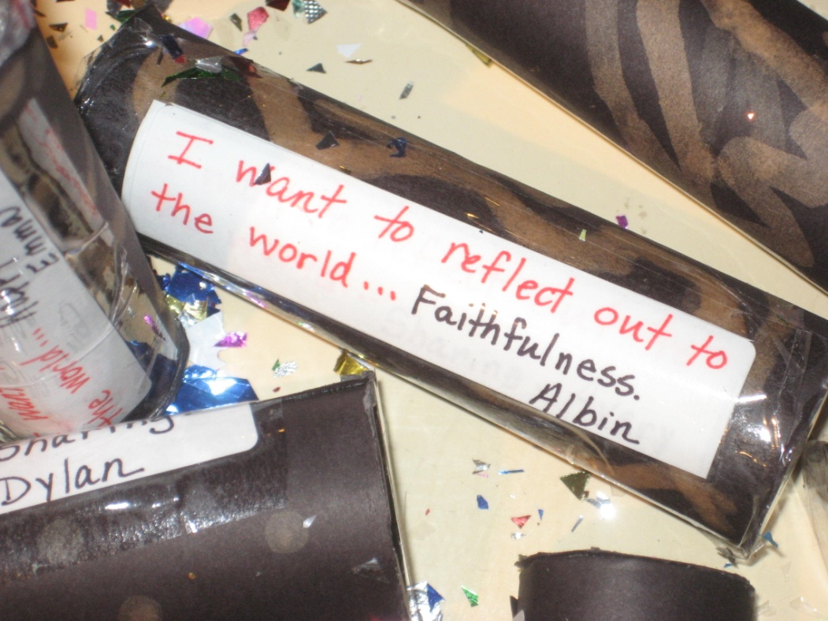
“Kid” Leidoscopes
We ARE the “KID”LEIDOSCOPES of hope and light for future generations!
Kindergarteners
Ranchwood Elementary School Yukon

Slide 20
Tri-City: Reduce, Reuse, Recycle
Tri-City is a 3-D city composed of recycled materials. We learned about caring for our world, and were challenged to become good stewards of our Earth. The name ‘Tri-City’ is inspired by the importance of implementing the 3 Rs: Reduce, Reuse, and Recycle in our everyday life.
Honorable Mention
2nd Graders and 5th Graders
Mark Twain Elementary
Oklahoma City Public Schools

Slide 21
We Love the Earth Necklace
The earth is our beautiful home. We had a discussion about the Earth. We love it and its people and animals and environments. Our students formed paper mache beads expressing our love for Earth by creating our Earth beaded art necklace.
Students
Lake Park Elementary School
Bethany

Slide 22
Perspectives of Peace… Respecting Each Other, Renewing the Earth
A post-consumer collage mobile
We realize that as our dynamic world turns, change happens.
We are free to help make things better in our World through the choices we make in consumption and in relationship.
We choose LIFE—sustainable, nurturing and interactive.
We choose PEACE!
6th – 12th Graders
John Marshall Multi-Cultural Club
John Marshall High School
Oklahoma City Public Schools

Slide 23
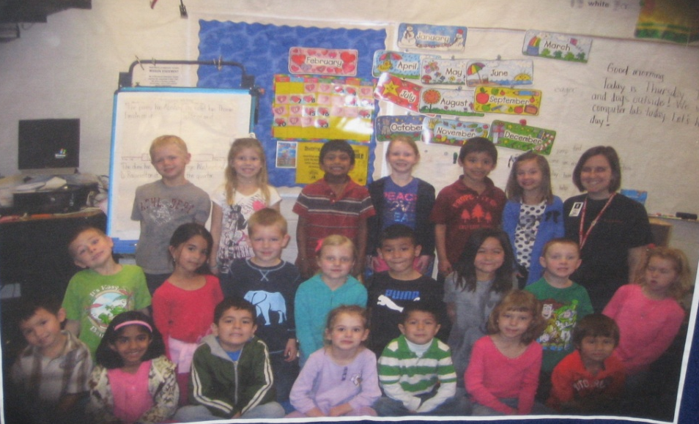
Many Faces, One Team
Our students decided early to embrace uniqueness and work together to reach our goals. We created a team flag. We came to the conclusion that we all are different but we come together to accomplish our goals.
Kindergarteners
Ranchwood Elementary School
Yukon

Slide 24
Giant Pinwheel for Peace
This work of art was designed by senior Devin Jenkins. The pole is painted with handprints from the Lower Division of Casady School. It was displayed at the 2010 Pinwheels for Peace celebration at the University of Central Oklahoma in honor of the annual International Day of Peace on September 21, 2010. This pinwheel was created to show the power of people through a group effort. The more people involved, the better.
Created by Seniors and Decorated by 1st – 4th Graders Casady School
Oklahoma City

Slide 25
Sea Diversity Unity in a Diverse Sea
Shells are all different sizes, different shapes and colors,
some can make sounds like the sea, some are smooth, others rough, all are different, but they all come from the same water. This is a beautiful example of Diversity.
Sea Diversity is a Multi-School Collaboration created by Margo Hewett & friends.
Sequoyah ES (teacher Gail Sloop), Edmond Cimarron MS (teacher Barbara Dubberstein) and John Marshall HS (teachers Natalie Bauer and Dora Lynn Gardner)

Slide 26
Melting Pot
With this project, the classes talked about diversity on our planet and in our country and communities. The students came up with the idea of creating a project around the melting pot theme to illustrate that we are a nation of many colors, cultures and gifts all mixed up together.
6th and 7th Grade Language Arts and Visual Arts Students Independence Charter Middle School
Oklahoma City Public Schools

Slide 27
Respect Diversity: The Garden Worth Tending
Recent events have prompted a good deal of discussion about civil discourse in our country.
Students address key issues through poetry, which we define as beautiful language. The results reveal admirable sensitivity and honest and profound observations.
11th Grade English Students
Lawton High School
Lawton

Slide 28
Within Us All, Next
This artwork represents the diversity of the artists that have a daily effect on our lives. We are shaped by artists, past and present, in all facets of life. Whether we struggle, excel, laugh, cry, feel loved, or unloved, we know that artists from around the world feel, and have felt the same shared human experiences.
K-12 Students
Dimensions Academy
Norman Public Schools

Slide 29
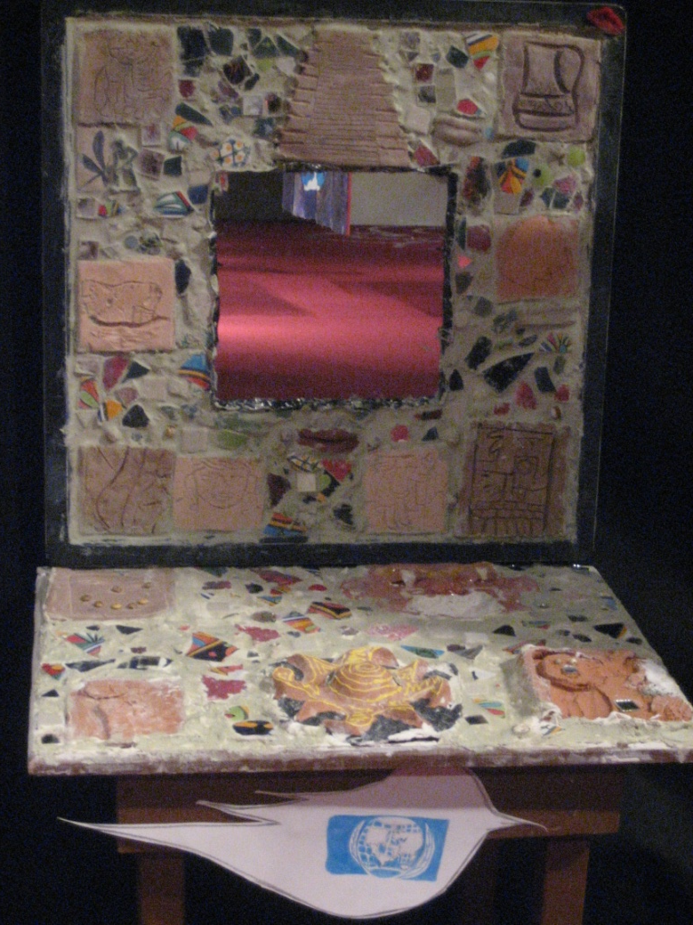
Growing of Cultures
The motivation for our entry was to create a sense of empathy and basic knowledge of the symbols, traditions and textures from the student’s choice of cultures.
9th – 12th Graders
Santa Fe South Charter Middle School
Oklahoma City Public Schools

Slide 30
Paper or Trees
Less than half of the paper used in the United States gets recycled…”
How much longer is it possible to consume natural resources before reaching their total depletion?
There has to be a way to change it. We do not want to ask the question:”Paper or Trees?”
The change is somewhere there in your mind. Sit down and think.
7th Graders
Justice Alma Wilson Seeworth Academy
Oklahoma City Public Schools

Slide 31
Patchwork of Peace
We, the Jets of Oklahoma City, build the “Patchwork of Peace” to keep our earth clean, to respect people, diversity and to care for God’s creatures.
1st – 5th Grade Students
Skyline Urban Ministries
Oklahoma City

Slide 32
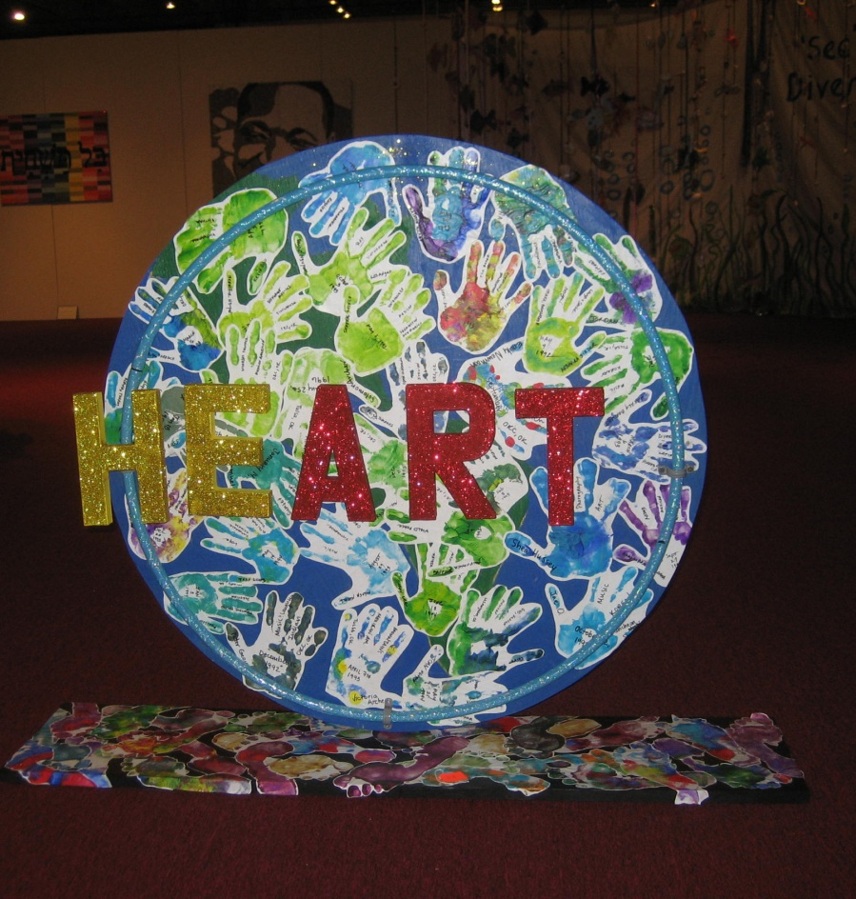
the heART of the earth
There is beauty in every aspect of diversity; there is art to be found within all life. As living beings—as the heart of our earth—we all share a need for love and care, to be given and received.
Multicultural Club
Southmoore High School
Moore Public Schools

Slide 33
Ecodragons
In our classroom, we have a recycle bin we put our discarded paper in. The question was, how can we use this and what should we do with it? We talked about how if we don’t stop using so much stuff, there won’t be anything left. We want to bring attention to this issue, so we upcycled our stuff into the Ecodragons to show that there can be a really cool purpose for our discarded things.
2nd Graders
Stand Watie Elementary
Oklahoma City Public Schools

Slide 34
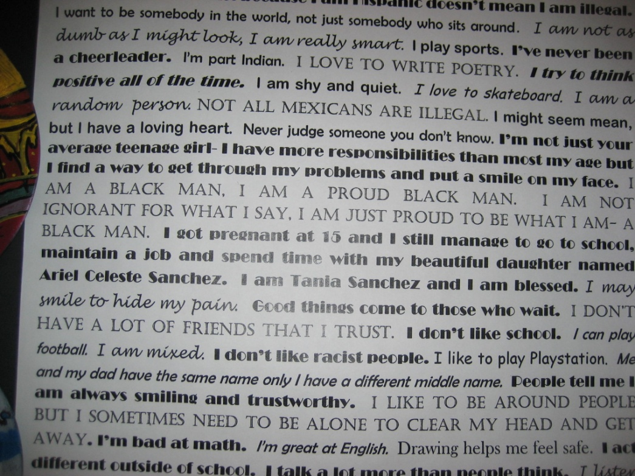
For the Record
“For the Record” is a collection of repurposed, painted vinyl records designed by Crooked Oak High School students to illustrate who they are in the world. After studying the negative effects of discrimination and prejudice, students created messages they would like stated "for the record" that would break stereotypes or misperceptions others might have about them regarding race, religion, nationality, gender, etc.
High School
Students
Crooked Oak High School
Crooked Oak Public Schools
Oklahoma City

Slide 35
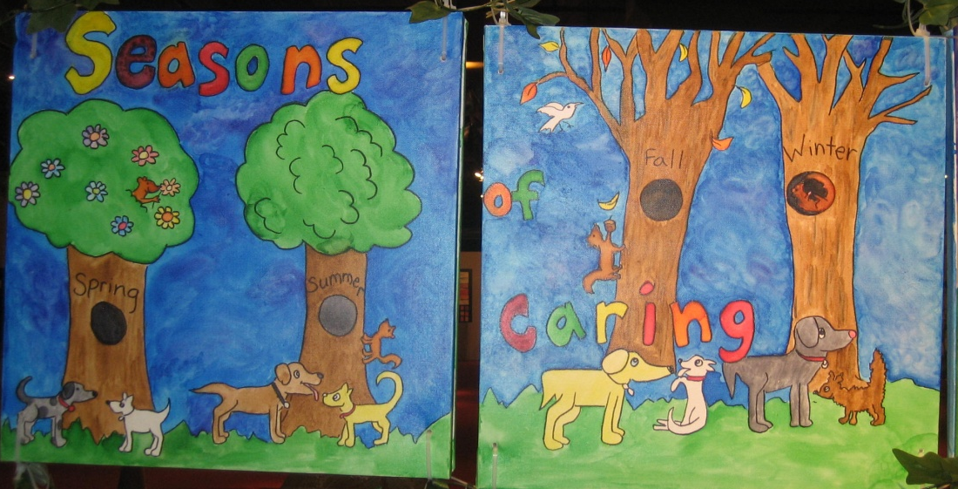
The Ties That Bind
The combined canvases represent the earth. The individual canvases represent the diverse people that make up the world. The many separate canvases displayed in an interconnected way show the synergy of global caretaking. Each individual is part of the whole. Its strength is dependent on its connectedness.
4th-5th Grades
Art Students
Jefferson Heights and Washington Elementary Schools
Sapulpa

Slide 36
The Earth is in Our Hands
Especially today it is important for all young people to understand that the care of the Earth is really in our hands. We used reclaimed materials for this project to reinforce the ideas of reducing, reusing, and recycling. So often we become wasteful because we live in a land of plenty. In creating this we looked at living conditions around the globe and talked about environmental issues that we can improve by making good choices and being good stewards of the Earth.
1st – 5th Graders
Northridge Elementary
Putnam City Public Schools

Slide 37
As Simple As A Grain of Salt
This watercolor mosaic portrait of Ghandi coincides with the students’ lesson on the salt march he organized. What importance and a difference he made with this march without harming anyone, or causing anyone to rebel with violence.
9th-12th Graders
Putnam City West High School
Putnam City Public Schools

Slide 38
Peace Box
“Peace Box” is a work of art from the Priority Boxes Art Series,” a peace initiative that has evolved into a movement.
This box has a label that reads, “Fragile, handle with care. Contains PEACE.”
By Artist
Franck de Las Mercedes,
a Nicaraguan born painter

Slide 39
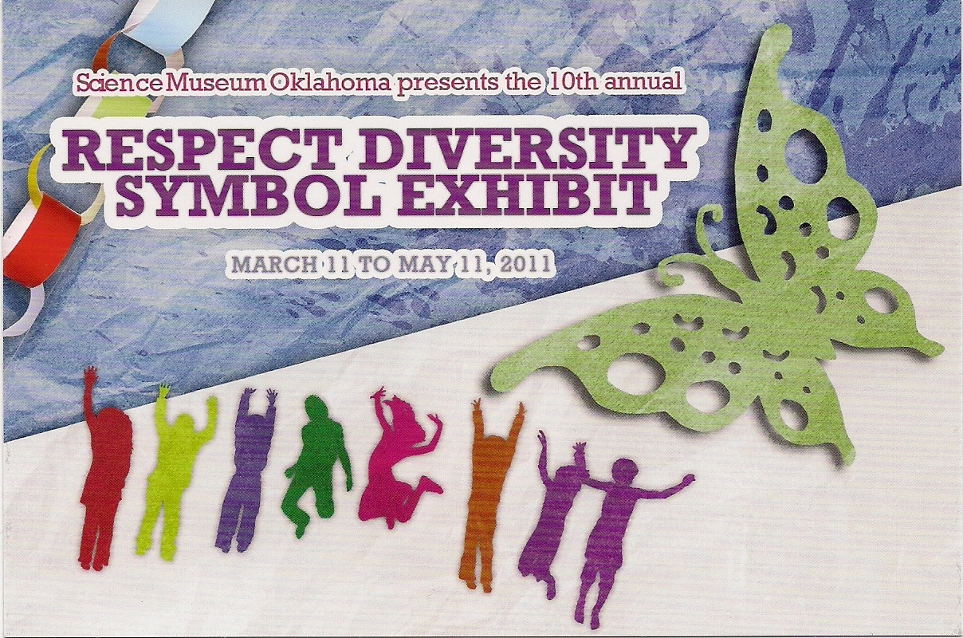
Respect Diversity Foundation
To learn more about the annual
Respect Diversity Art
and Poetry Contest
Contact
Joan Korenblit
rdfrdf@cox.net

